Slide 1





Using Linked Lists for Sparse Matrices in IPL Data Analysis
Md Faizan Ansari [24PG00019]
Harshvardhan Manavalan [24PG00017]
Muskan Kumari [24PG00076]
Abhilash G [24PG00068]

Slide 2




Objective of the Project
Why Sparse Matrices?
IPL datasets contain large matrices with mostly zero values.
Using traditional arrays wastes memory.
Why Linked Lists?
They allow dynamic memory allocation, storing only non-zero values.
Key Goals:
Optimize memory storage for IPL performance data.
Improve efficiency in data retrieval and manipulation.
Identify and analyze all-rounder performances efficiently.

Slide 3
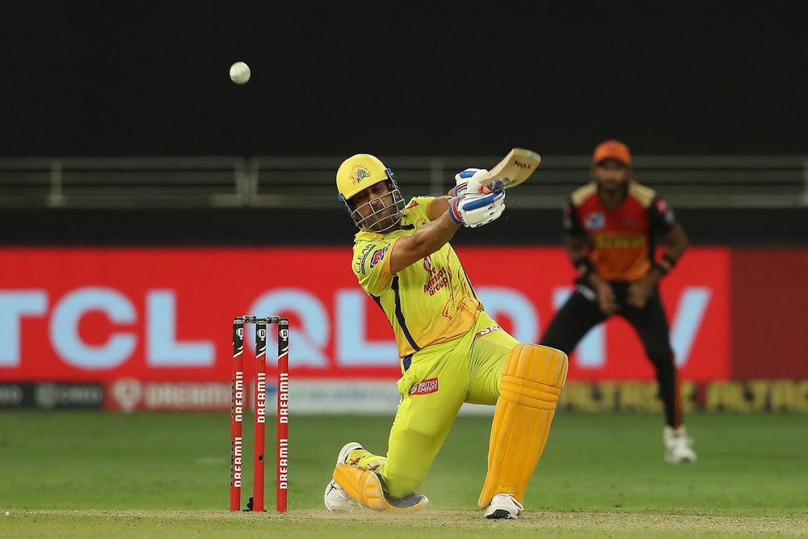

Introduction to Sparse Matrices
Definition
A sparse matrix is a matrix where most elements are zero.
Why Not Use Normal Matrices?
Memory overhead is high.
Processing large matrices is slow.
Applications of Sparse Matrices
Graph representation in networks.
Machine learning (storing user-product interactions).
Image processing and scientific computing.

Slide 4


Introduction to Linked Lists
Definition :
A linear data structure consisting of nodes where each node contains:
Row index (Which player?)
Column index (Which match?)
Value (Did the player perform well? 1 or 0)
Pointer to the next node
Advantages over Arrays :
Dynamic memory allocation.
Efficient Storage
Efficient insertion and deletion operations.

Slide 5
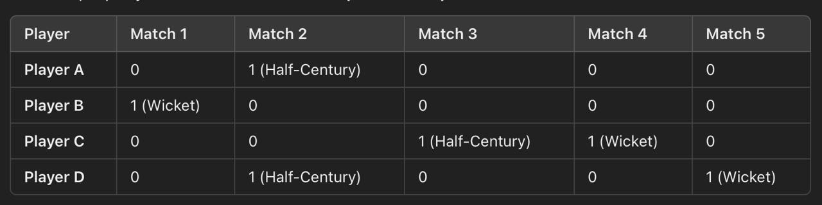
Sparse Matrices in IPL Data
Sparse Matrices in IPL Data
Dataset Description -
The dataset captures IPL player performance across multiple matches, structured as two sparse matrices:
Half-Centuries Matrix → Records whether a player scored 50+ runs in a match.
Wickets Matrix → Tracks whether a player took a wicket in a match.
Each row represents a player, and each column represents a match, with values indicating specific achievements:
1 → Player achieved the milestone
0 → Player did not achieve the milestone.
Advantages of Sparse Matrix Representation in IPL Analysis:
Efficient storage and retrieval of key performance data.
Reduces memory wastage by avoiding unnecessary zero values.
Enables faster analysis of player statistics across matches.
Example Data Representation

Slide 6



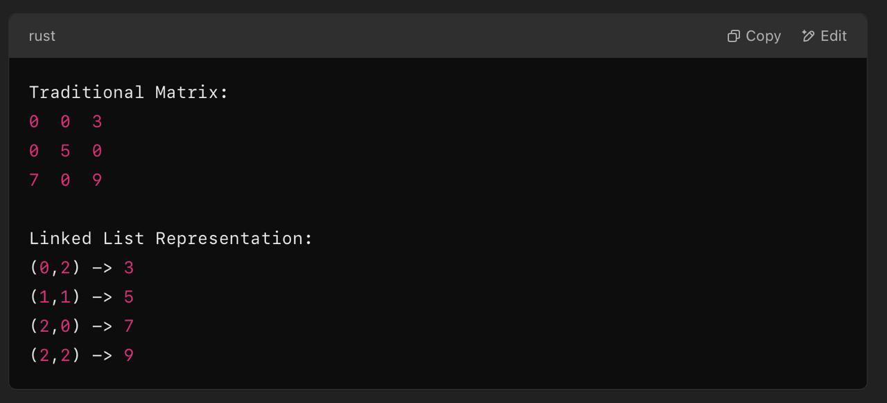

Data Structure Design for Sparse Matrices
Linked List Representation:
Each node contains: (Player Number, Match Number, Value, Pointer).
Comparison with Array-based Storage:
Traditional Array: Stores all values, even zeros → Inefficient.
Linked List : Stores only non-zero values → Memory-efficient.
Example :

Slide 7
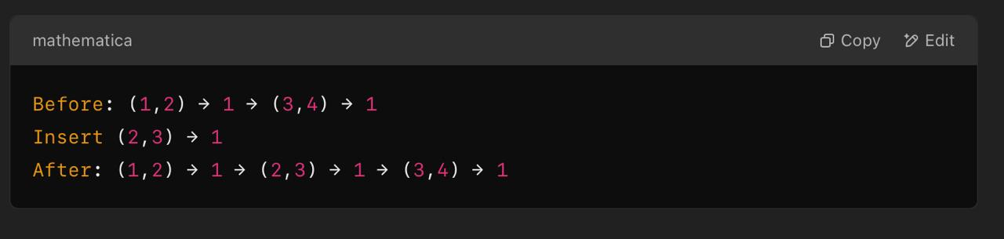
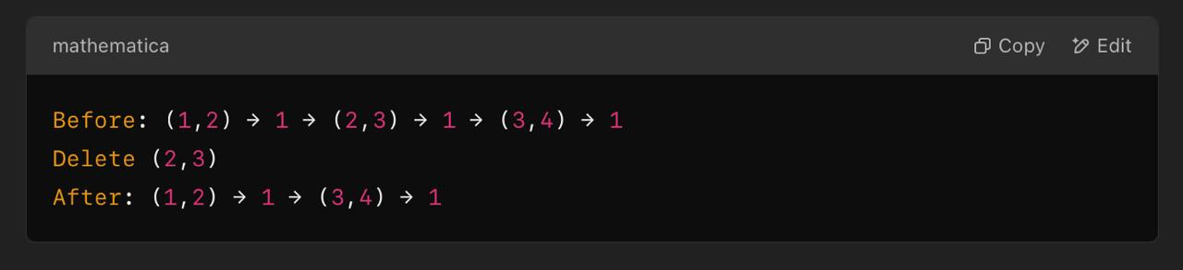
Key Operations in Sparse Matrix & Linked Lists
Efficiently managing sparse matrices using linked lists involves four key operations: Insertion, Deletion, Searching, and Traversal Efficiency.
Insertion
Adds non-zero elements dynamically without allocating memory for zeroes.
Each node stores (Row, Column, Value, Pointer).
Example:
2. Deletion
Removes specific non-zero elements without affecting others.
No shifting needed, unlike arrays.
Example:
3. Searching & Traversal
Search: Finds specific player records quickly by traversing only non-zero elements.
Traversal: More efficient than 2D arrays, as only relevant data is accessed.
2D Array: O(n × m) (Scans all elements).
Linked List: O(non-zero elements) (Skips unnecessary zeroes).

Slide 8
File Handling & Error Detection
Reading Data from Files
IPL performance data is stored in text files (e.g., half_centuries.txt, wickets.txt).
The program reads these files and extracts relevant information, converting it into a sparse matrix representation using a linked list.
2. Error Detection :
To maintain data accuracy, the system performs three key checks:
Undeclared Players
Ensures that every player referenced in the dataset exists in the player records.
b) Duplicate Entries
Checks if a player's performance data for the same match is accidentally recorded multiple times.
c) Incorrect Data Types
Ensures that all values follow the expected format (e.g., numerical values for scores).

Slide 9

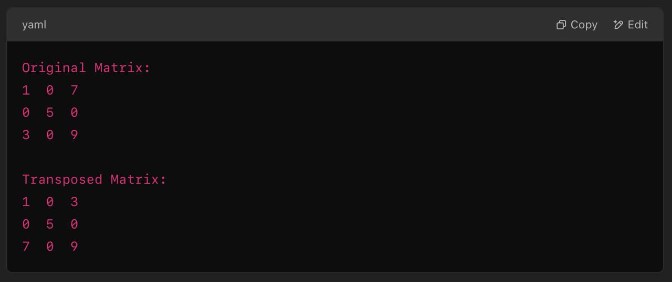


Transposing the Sparse Matrix
Why Transpose the Matrix?
Switching player-wise analysis to match-wise analysis.
Algorithm:
Swap row and column indices in linked list nodes.
Example:
Implementation in Linked List:
Swap indices while traversing the list.

Slide 10


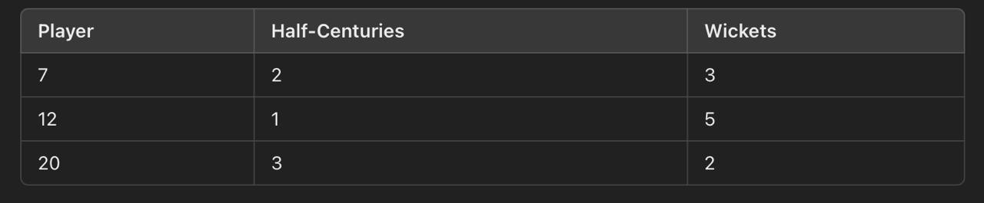

Identifying All-Rounders
Definition:
A player who has both scored a half-century and taken wickets.
Process:
Traverse the Half-Centuries Linked List.
Traverse the Wickets Linked List.
If a player appears in both lists, add them to the All-Rounders List.
Example Output:

Slide 11


Performance Measurement
Execution Time Analysis (using <time.h>):
File Reading: 0.001 sec
Error Detection: 0.005 sec
Matrix Transpose: 2.254 sec
Memory Usage Comparison:
Traditional Array: High memory consumption.
Linked List: Optimized for non-zero values.
Time Complexity Analysis:
Insertion: O(1)
Deletion: O(1)
Search: O (n)

Slide 12

Challenges & Solutions
Challenge 1: Large Dataset Processing
Solution: Use linked list traversal instead of full matrix scans.
Challenge 2: Handling Sparse Matrix Deletion
Solution: Implement lazy deletion to mark deleted nodes instead of removing them immediately.
Challenge 3: Collision Handling in Hashing (If Used)
Solution: Use chaining with linked lists.

Slide 13
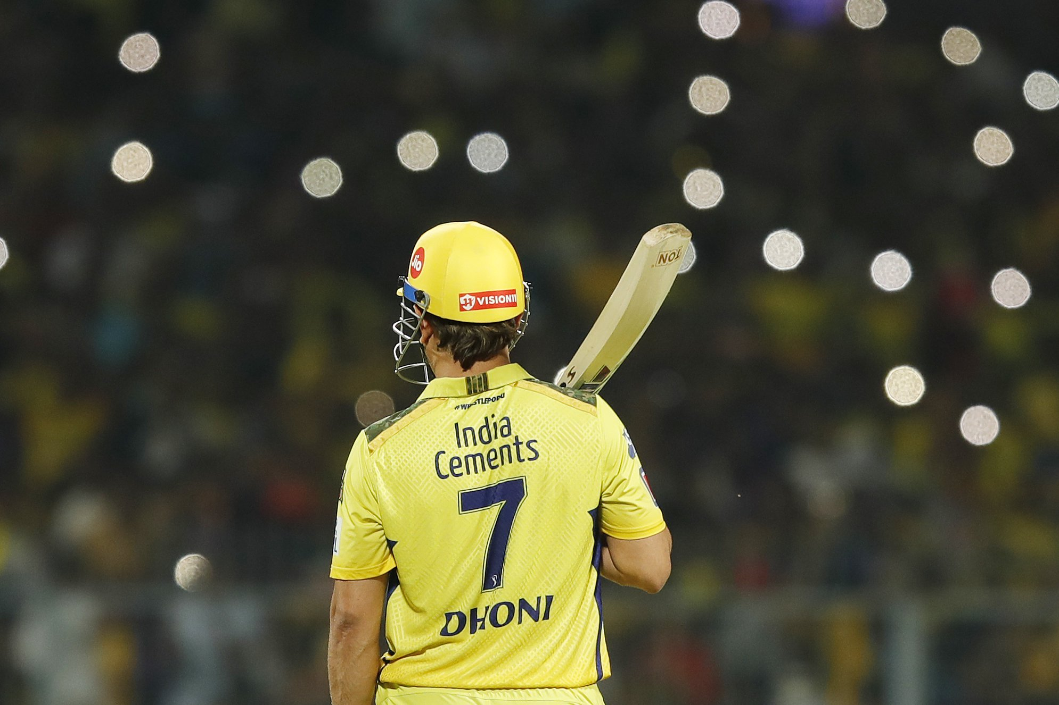
Conclusion & Future Enhancements
Findings:
Linked lists significantly reduce memory usage.
All-rounder identification is efficiently handled.
Future Work:
Dynamic Resizing: Handle changing dataset sizes.
Graph-Based Representation: Improve efficiency with adjacency lists.
Better Hash Functions: Optimize lookup operations.

Slide 14




THANK YOU

